Slide 1


PRESENTATION ON CIRCLE

Slide 2

Contents :
Introduction
Types of circle
Example of circle
Equation of a circle
The properties of circle

Slide 3

Introduction of circle
The locus of a point which moves in a plane such that its distance from the fixed point is always constant is called circle. Where fixed point is center and constant distance is radius. It is the example of conic section.

Slide 4
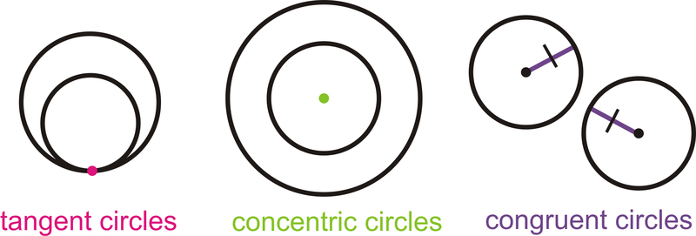
Types of circle
Concentric: Those two or more circles that intersect each other at one point.
Tangent circle:: Two or more circles that intersect at one point.
Congruent: Those two or more circles that has the same radius but different centers.

Slide 5

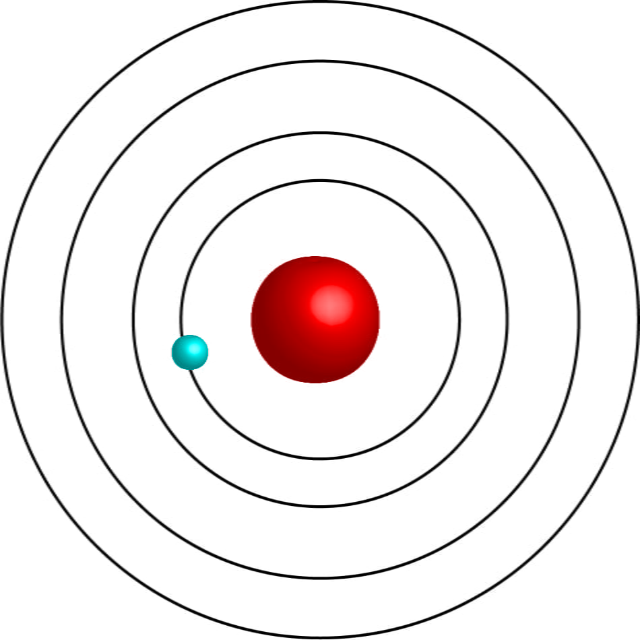
Example of circle:
Clock
CD
Coins
Ring
Wheels
Orbit of electron

Slide 6

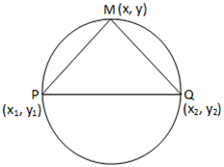
Equation of a Circle:
If the center of circle is at (h , k) and radius is ‘a’ then the equation of circle is given by
(x-h)² +(y-k)² =a²
If center is at origin then h=k=0. in this case, the equation of circle is x² +y² =a² which is standard equation of circle.
The general equation of circle is:
x²+y²+2gx+2fy+c=0.
If P(x₁,y₁) and Q(x₂,y₂) be the end points of the diameter and M(x,y) be any point on the circle. Then the equation of circle is given by
(x-x₁)(x-x₂)+(y-y₁)(y-y₂)=0,

Slide 7

The properties of circle x²+y²+2gx+2fy+c=0 are:
Coefficient of x²= Coefficient of y².
If g²+f²-c>0, the radius is real and the circle is also real.
If g²+f²-c=0, the radius is zero and the circle is reduced to the point (-g , -f). It is called a point circle.
If g²+f²-c<0, the radius is imaginary.
We can make the coefficient of x² and y² each 1 by dividing throughout (if necessary) by the coefficients of x² and y².

Slide 8





Any Questions ?

